Slide 1

Quantum Information and Computing
2021 - 2022
Saverio Monaco
28/11/2021
Solution of the Time Independent
Schrödinger Equation for
an harmonic oscillator

Slide 2
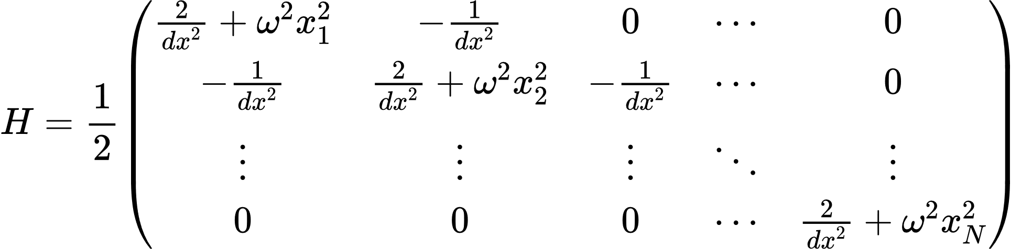
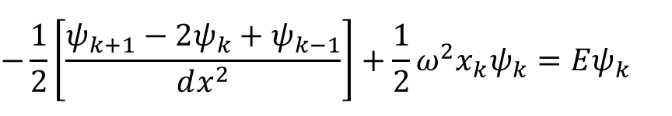

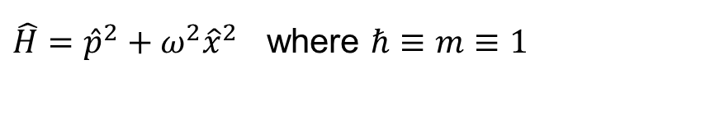
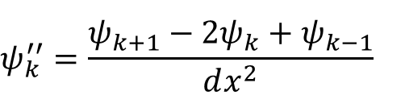
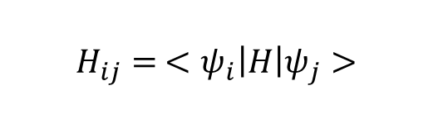
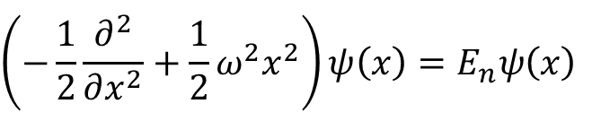
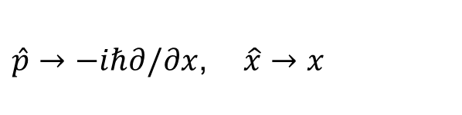
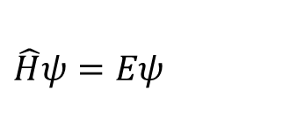
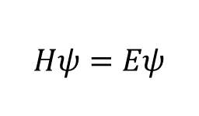
Theory
$\hat{H}={\hat{p}}^{2}+{ω^{2}\hat{x}}^{2}$ where $ℏ≡m≡1$
$$\left(−\frac{1}{2}\frac{∂^{2}}{∂x^{2}}+\frac{1}{2}ω^{2}x^{2}\right)ψ\left(x\right)=E_{n}ψ\left(x\right)$$
$$\hat{H}ψ=Eψ$$
$\hat{p}→−iℏ∂/∂x$, $\hat{x}→x$
$$ψ_{k}^{′′}=\frac{ψ_{k+1}−2ψ_{k}+ψ_{k−1}}{dx^{2}}$$
$$−\frac{1}{2}\left[\frac{ψ_{k+1}−2ψ_{k}+ψ_{k−1}}{dx^{2}}\right]+\frac{1}{2}ω^{2}x_{k}ψ_{k}=Eψ_{k}$$
$$H_{ij}= <ψ_{i}\left|H\right|ψ_{j}>$$
$$Hψ=Eψ$$
$$dx≡\frac{L}{N}$$
Notes:
Explain very briefly the theory you have based your solution on

Slide 3
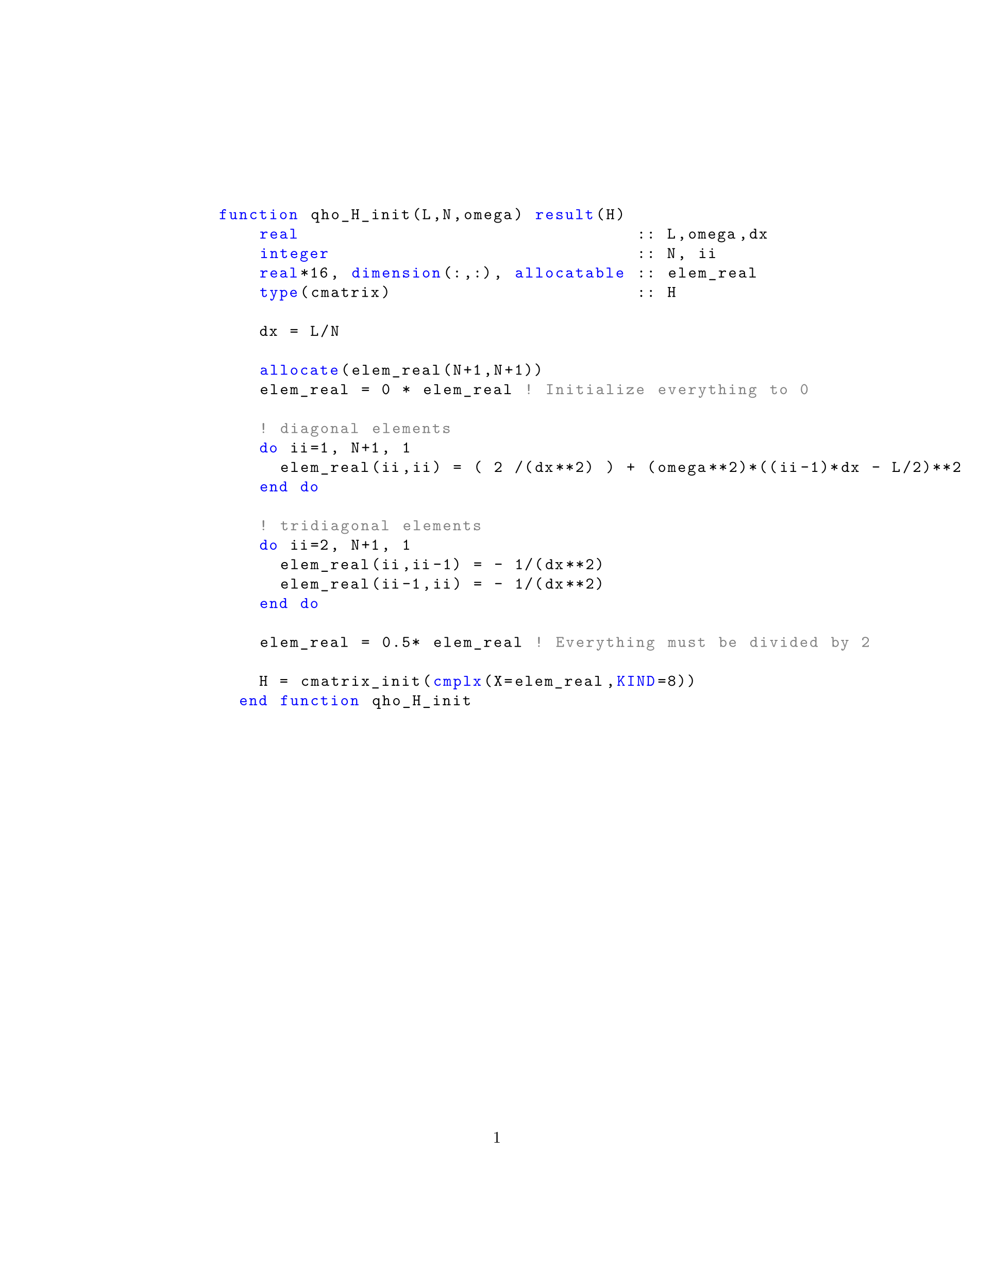
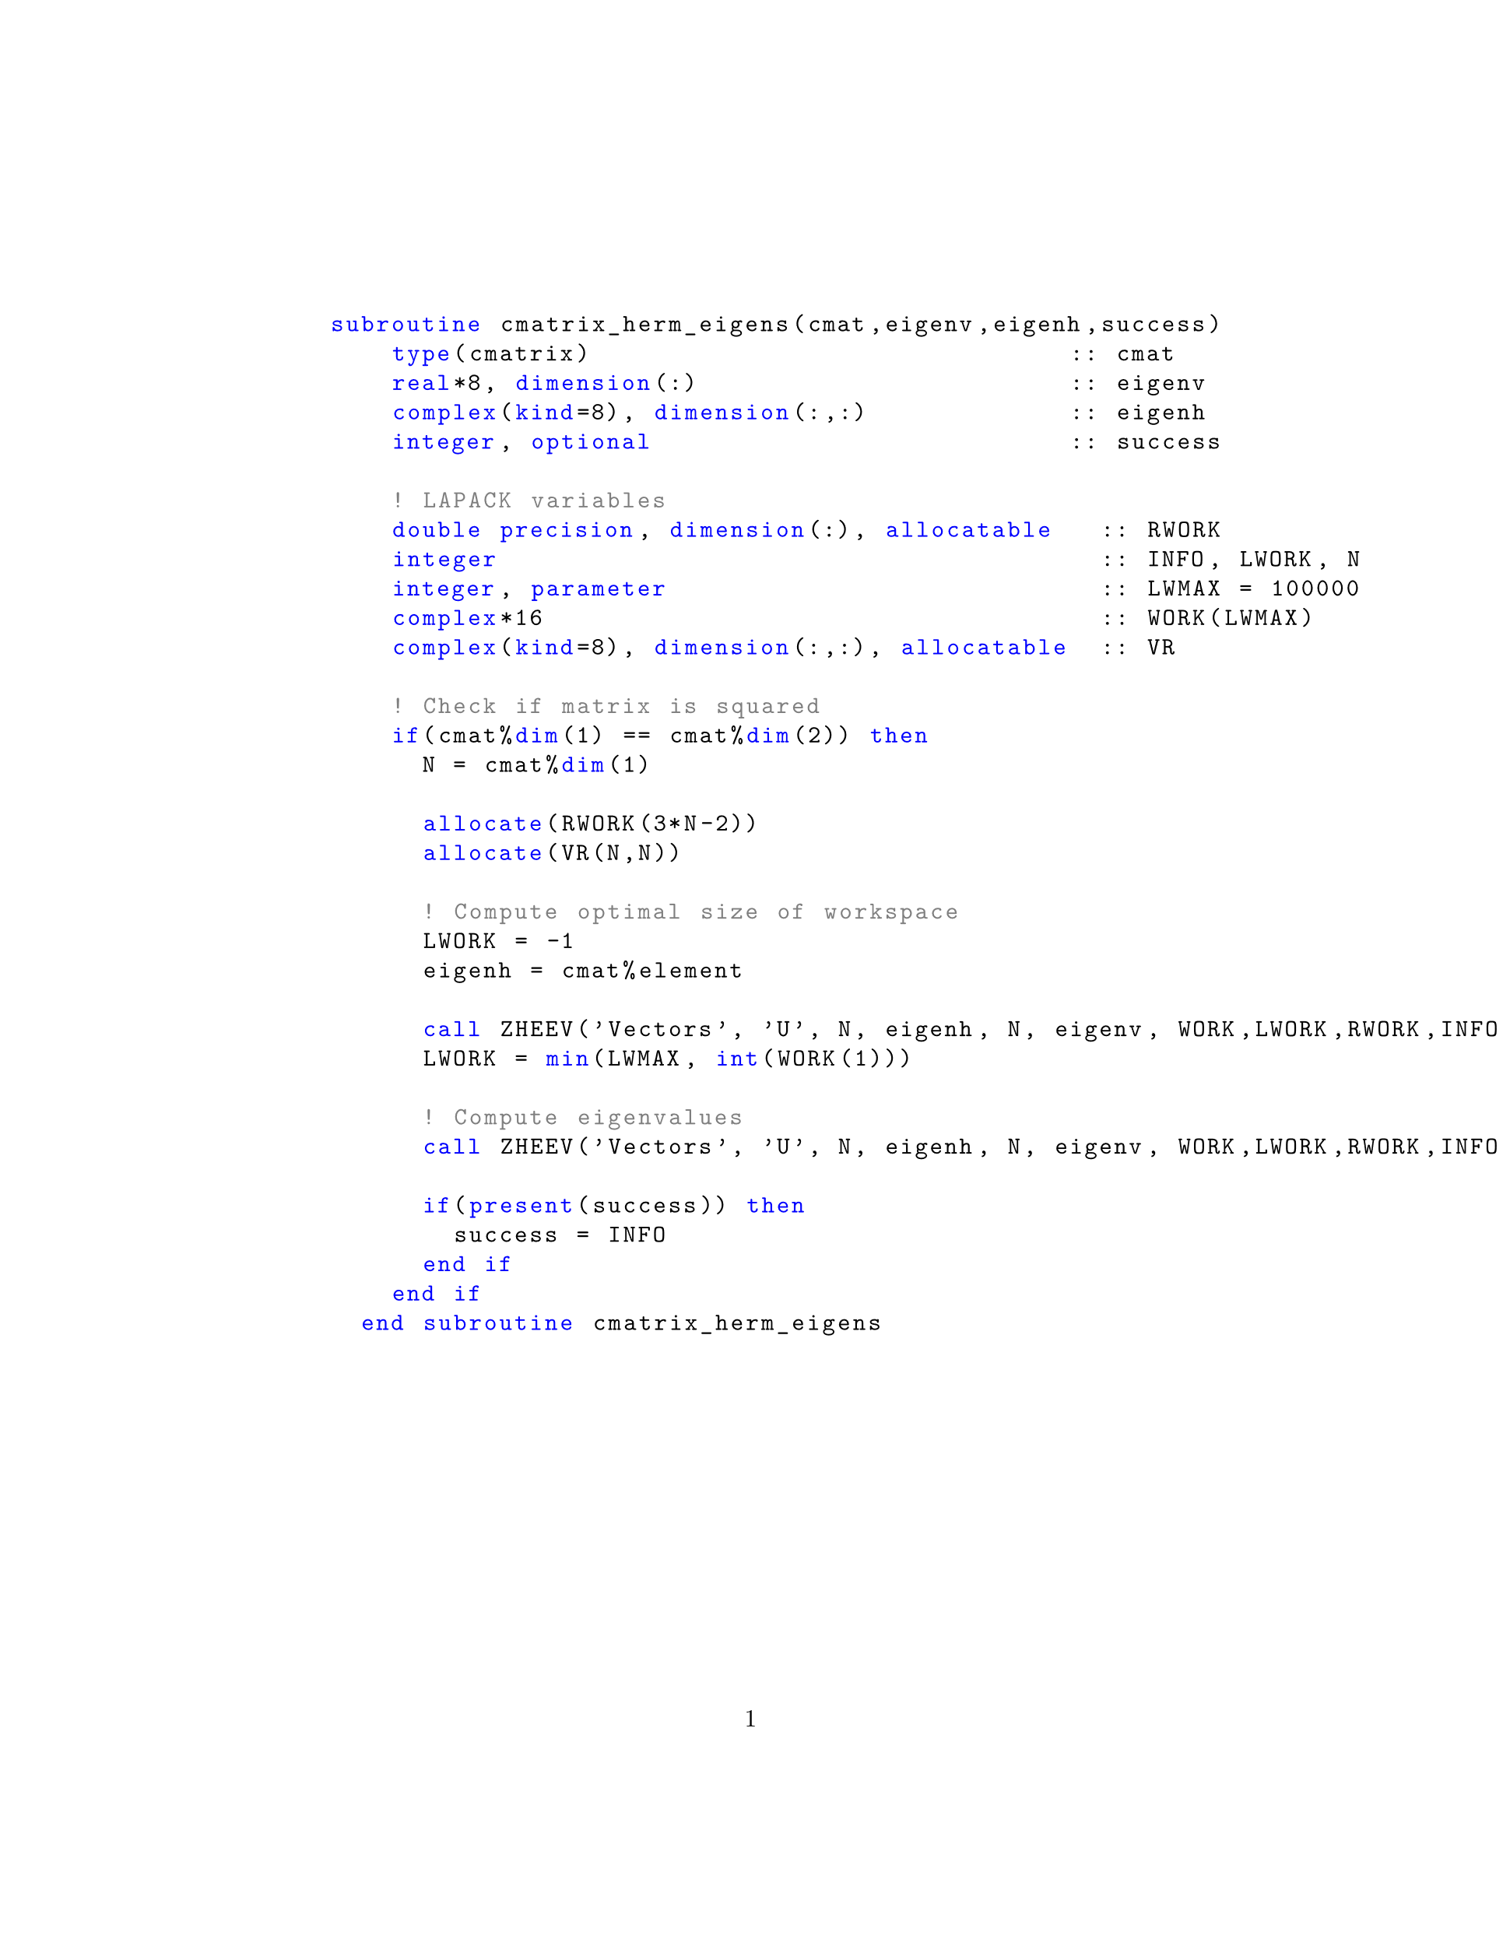
Code Development
To initialize the complex matrix to
represent the hamiltonian of the
system given L and N
To compute eigenvalues and
eigenvectors
Notes:
Introduce strategies, tests, and report debugging problems, compilation options

Slide 4
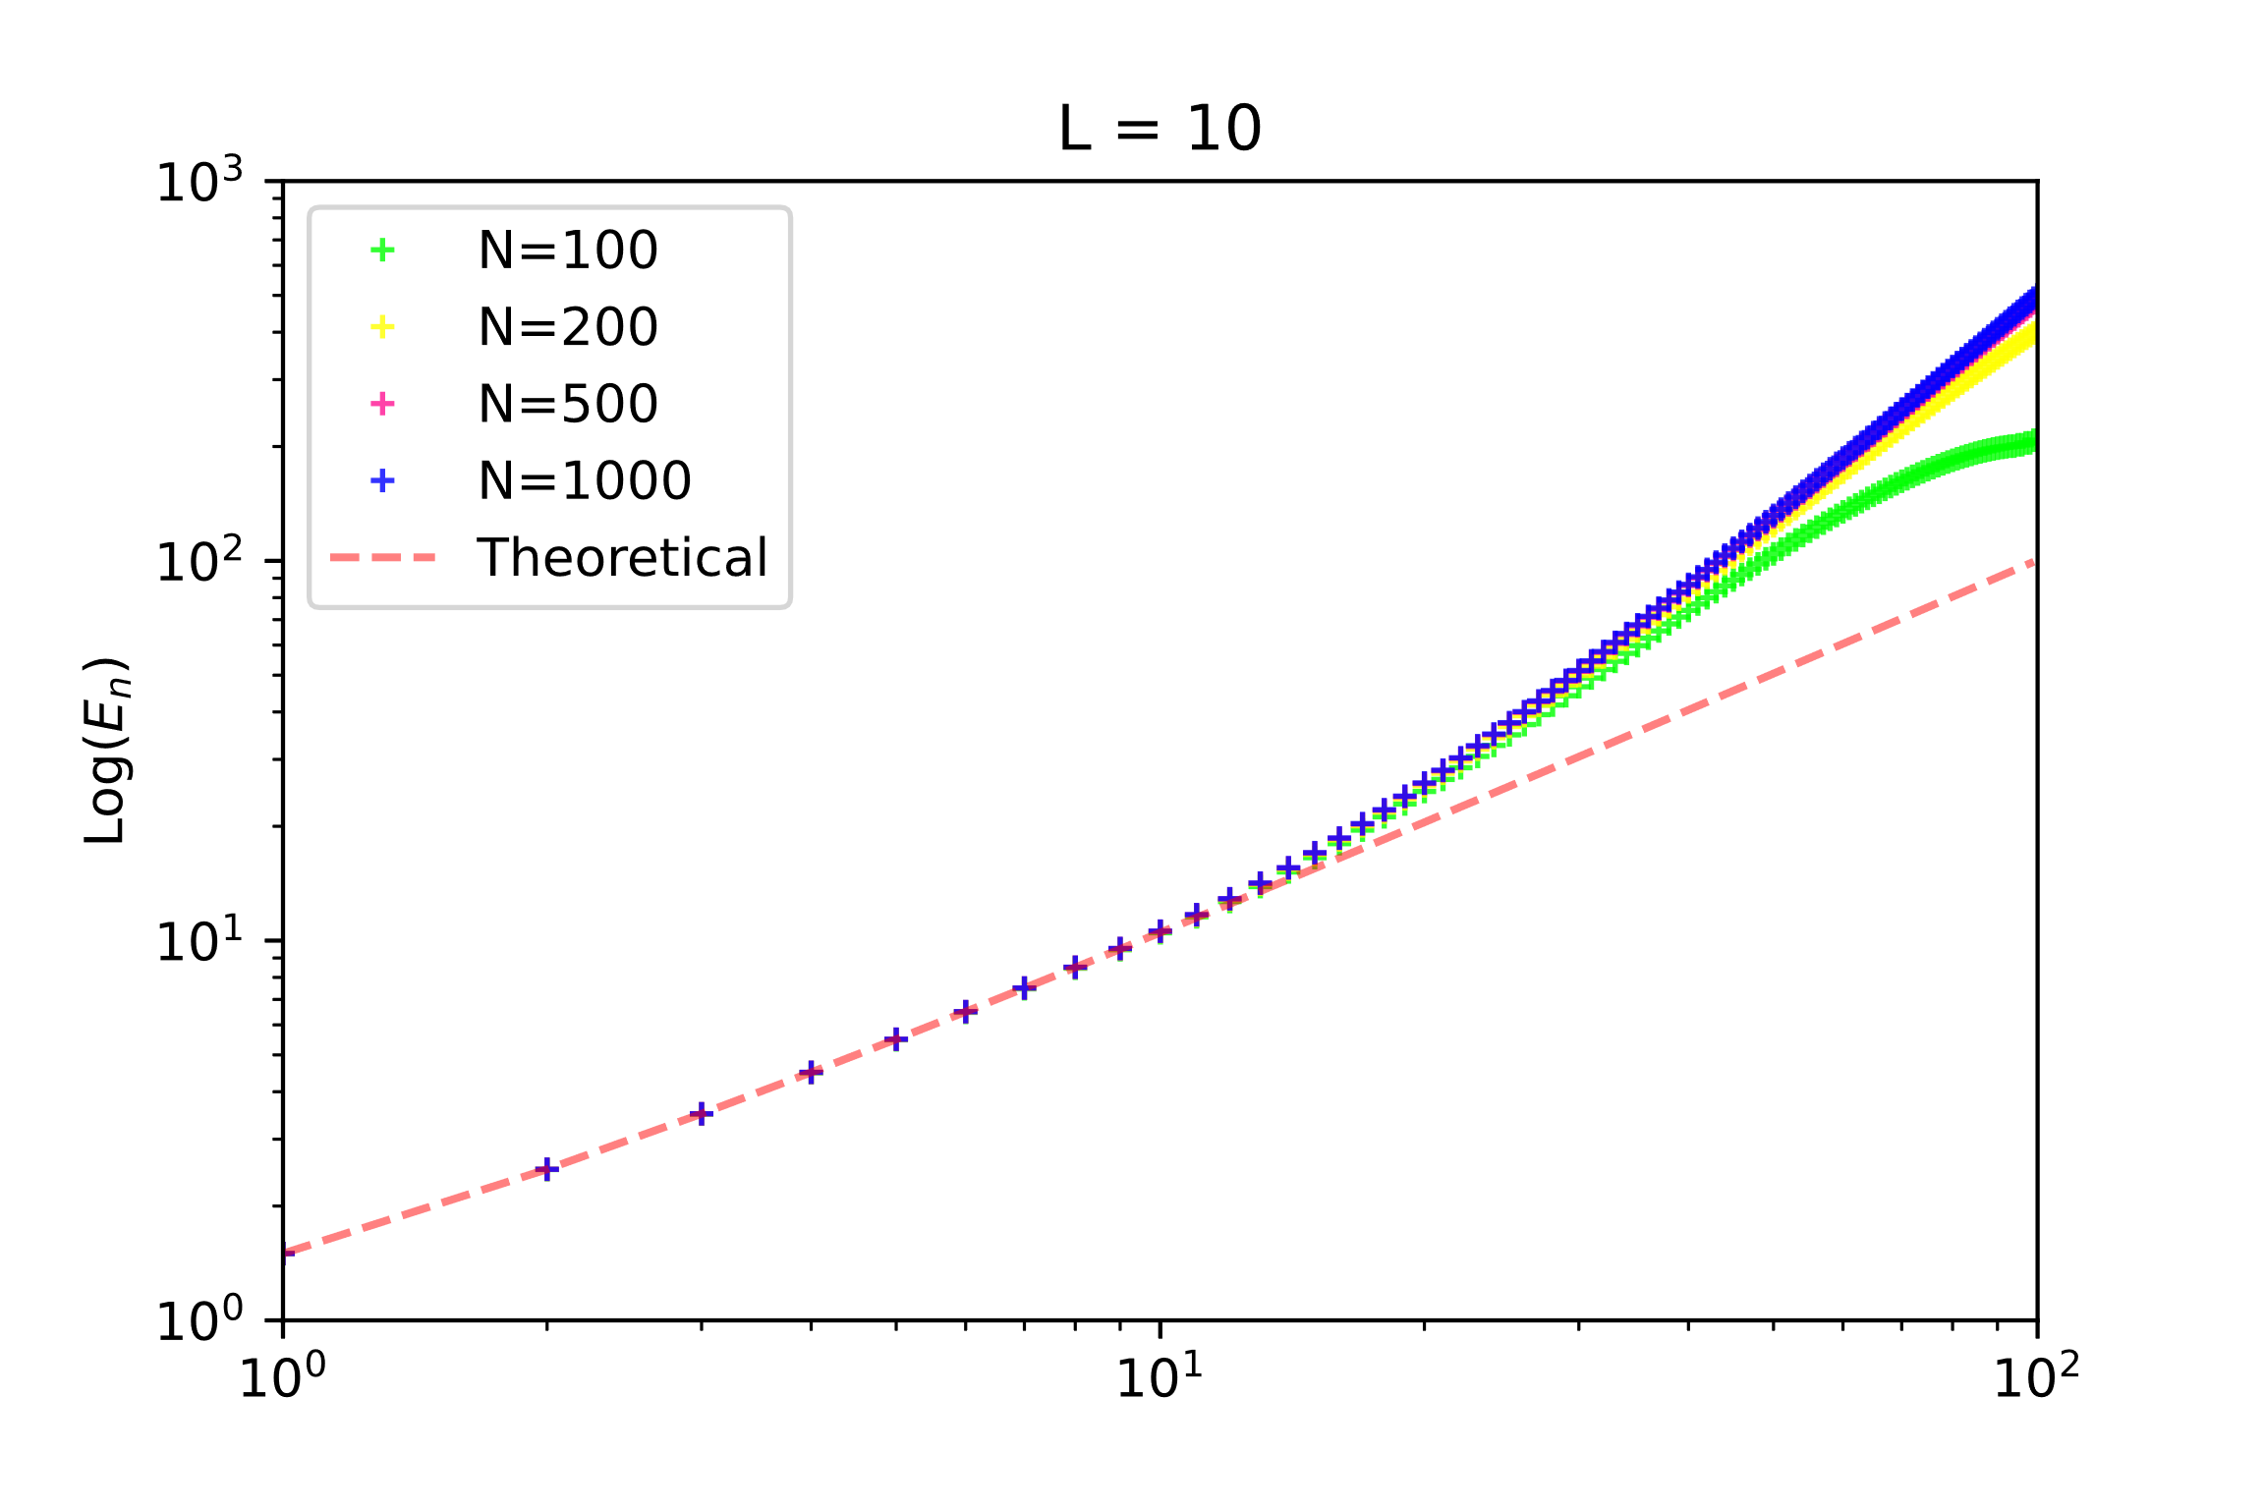
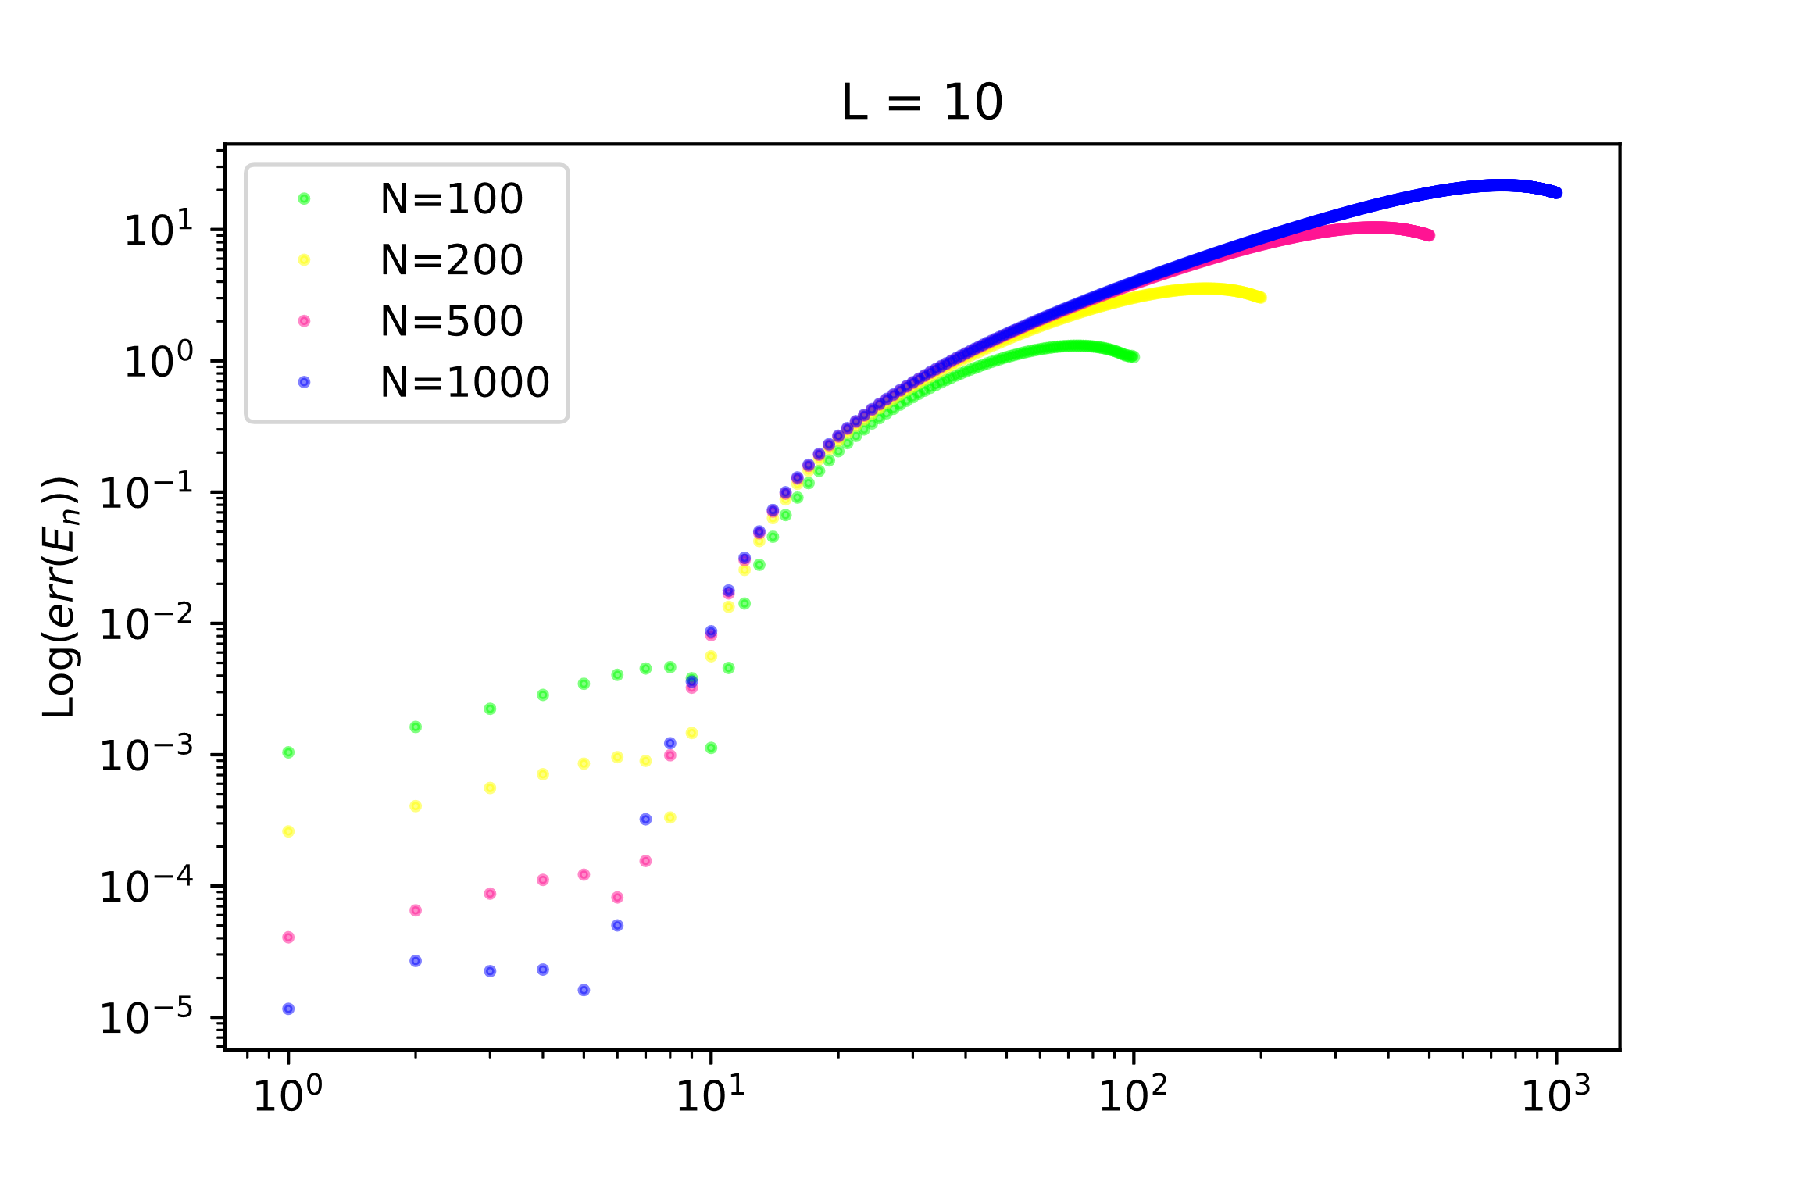
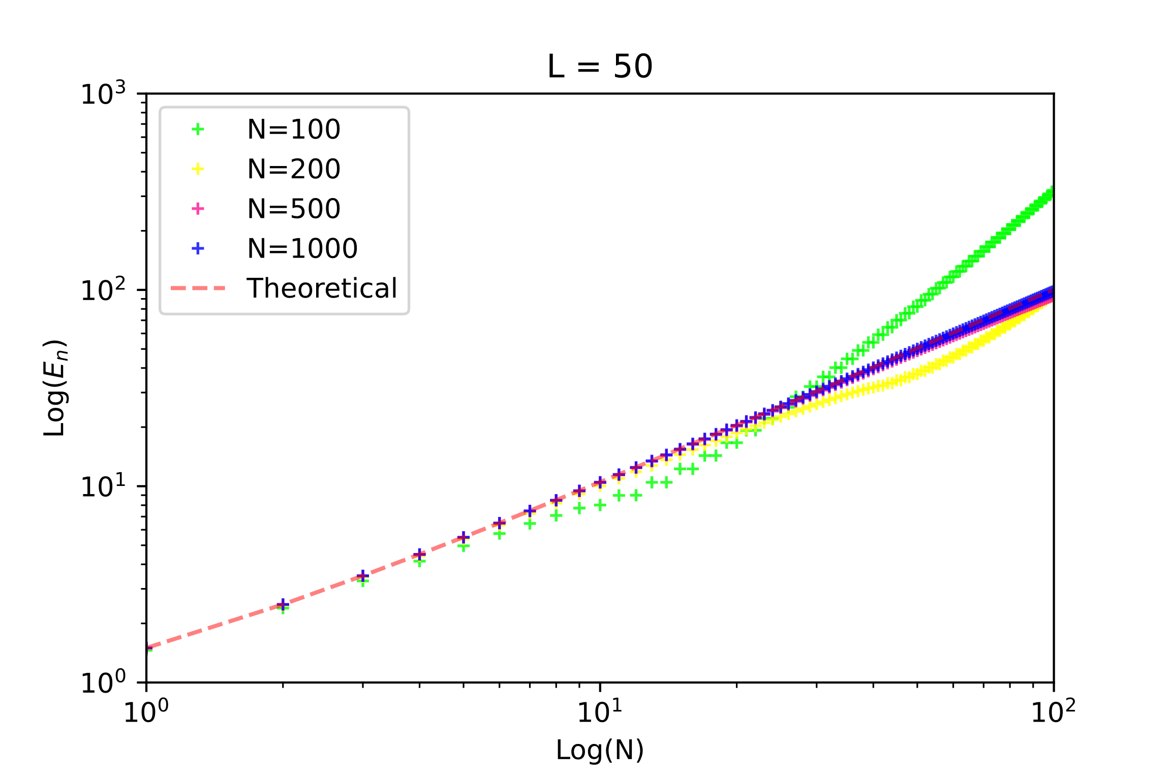
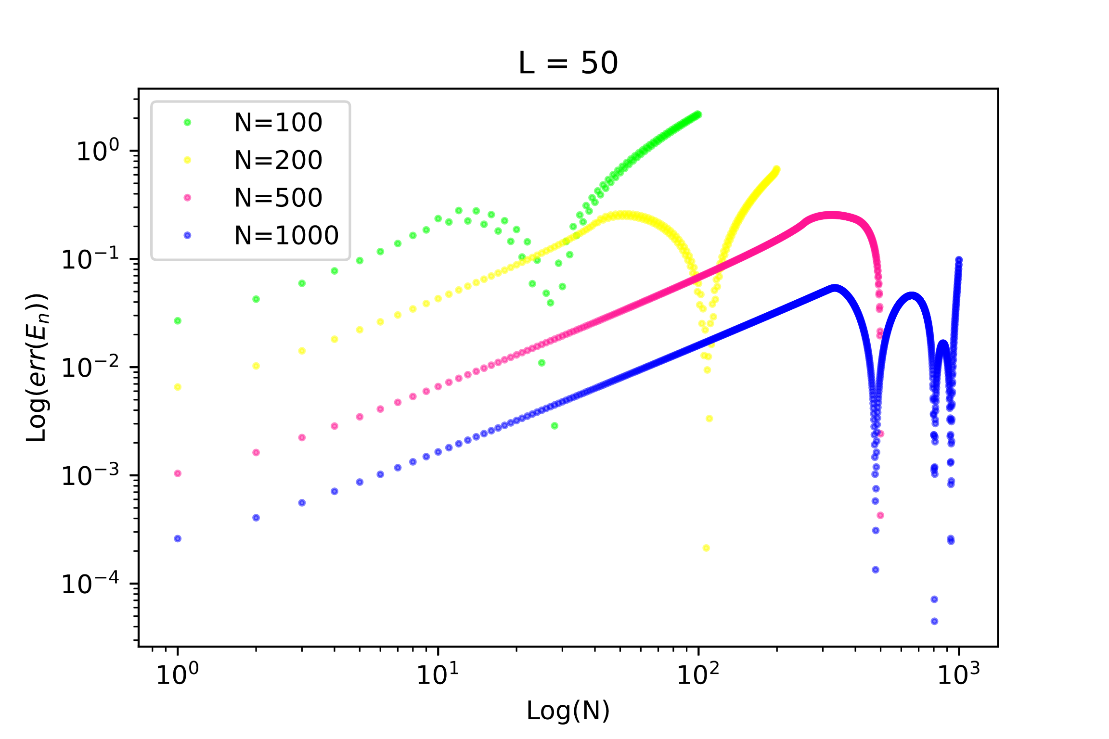


Results
$$E_{n}^{true}=ω\left(n+\frac{1}{2}\right)$$
$$err\left(E_{n}\right)≡\frac{|E_{n}−E_{n}^{true}|}{E_{n}^{true}}$$
Notes:
Present data and explain your results

Slide 5
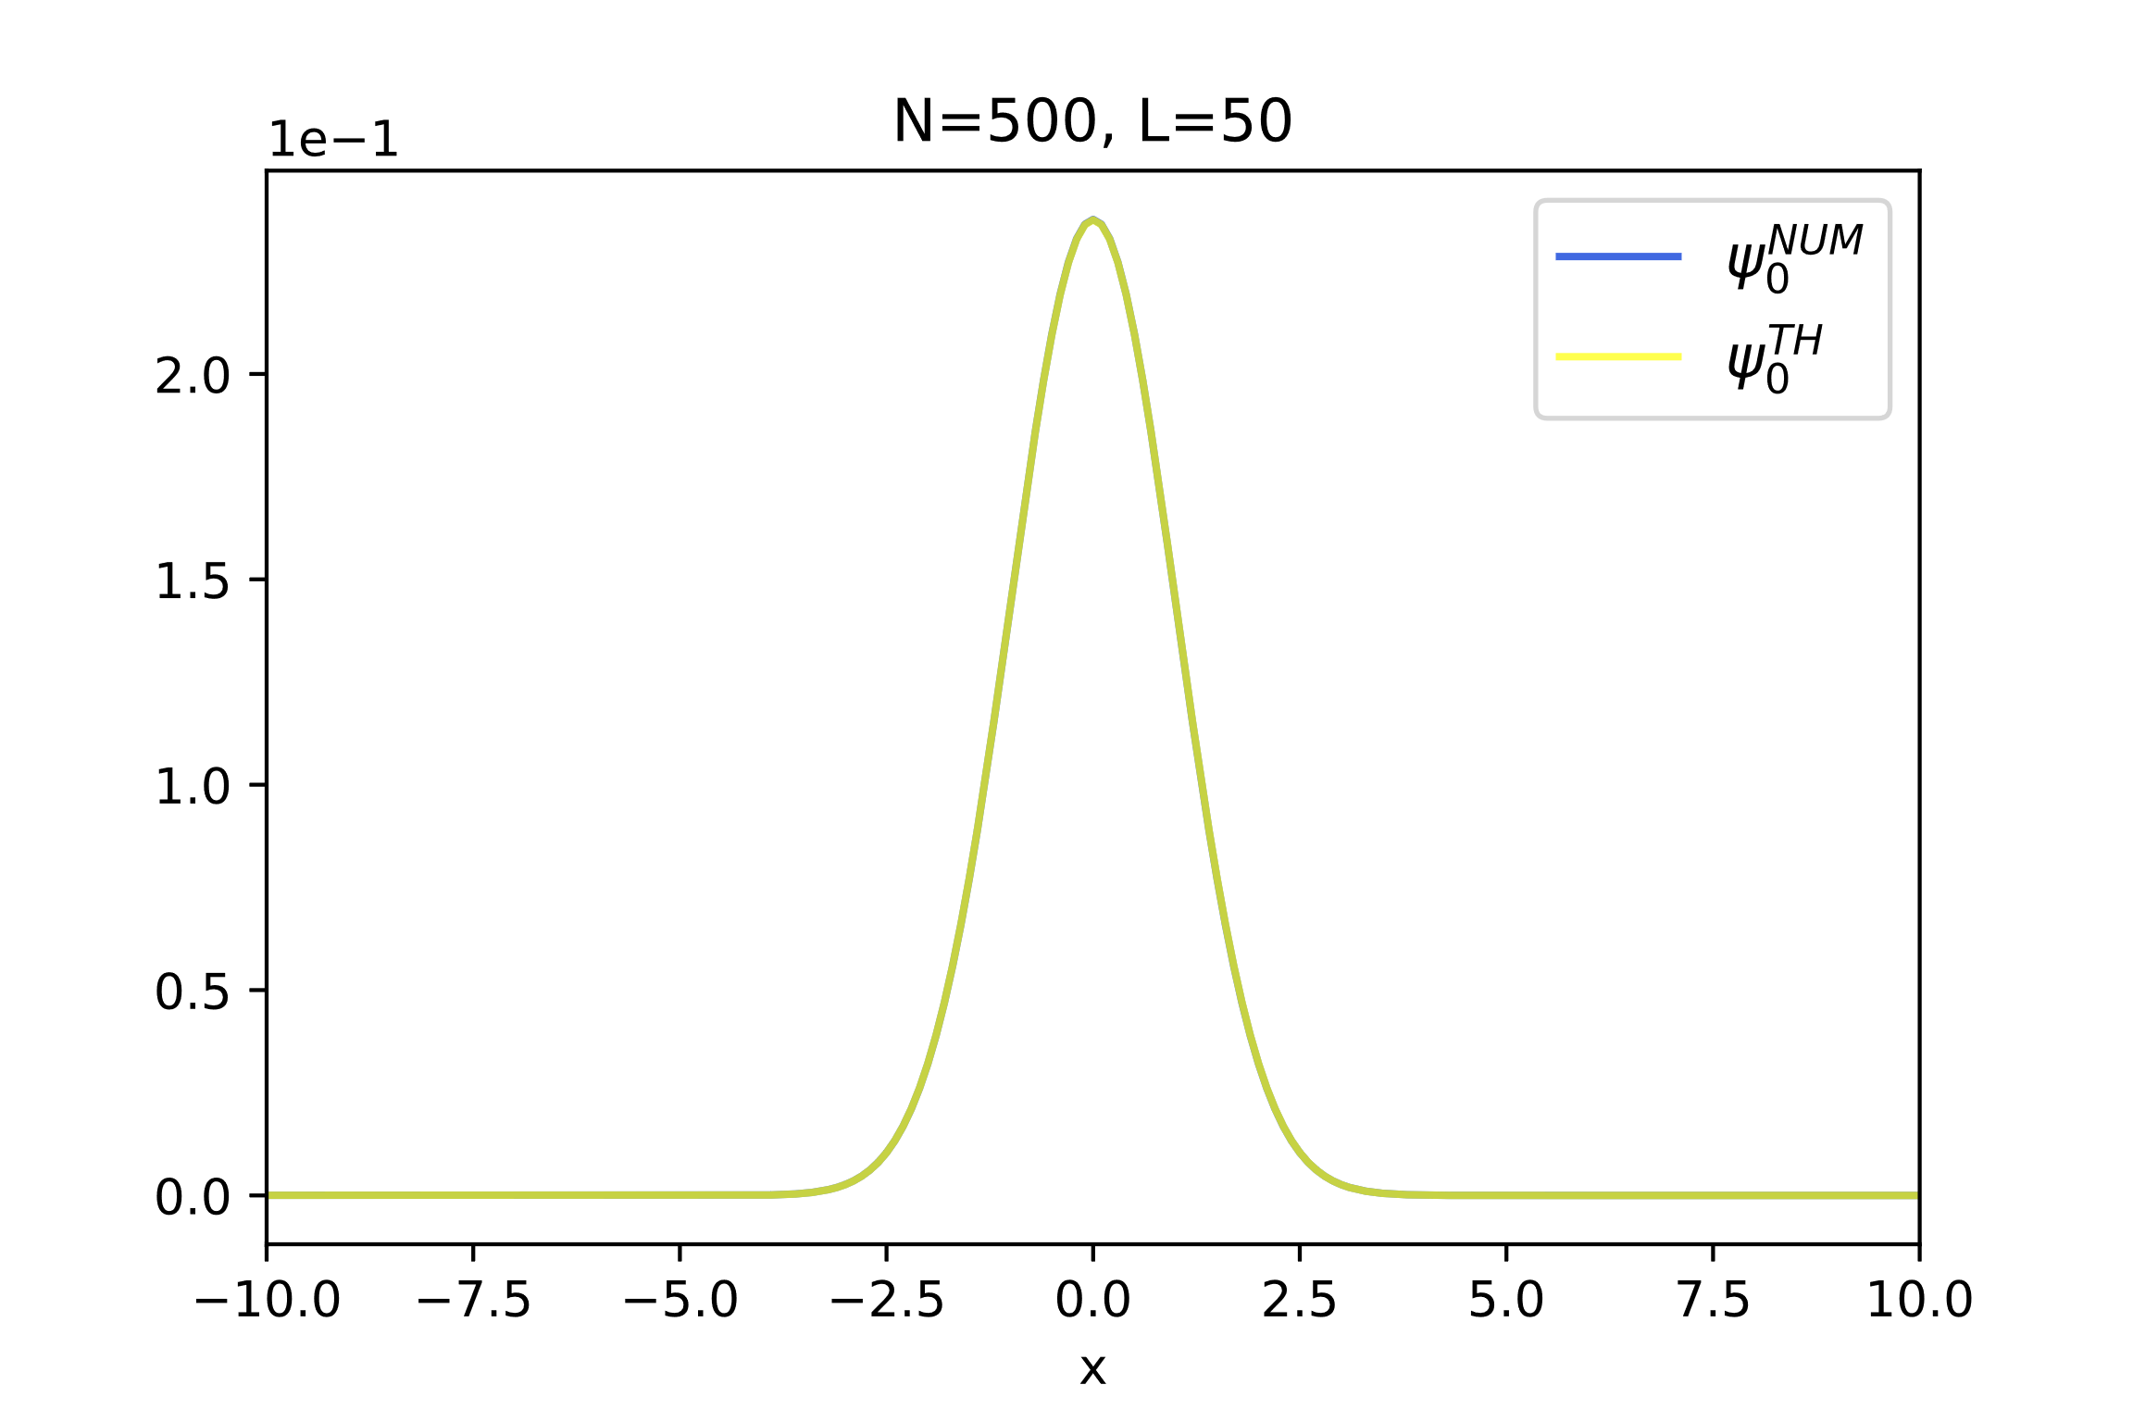
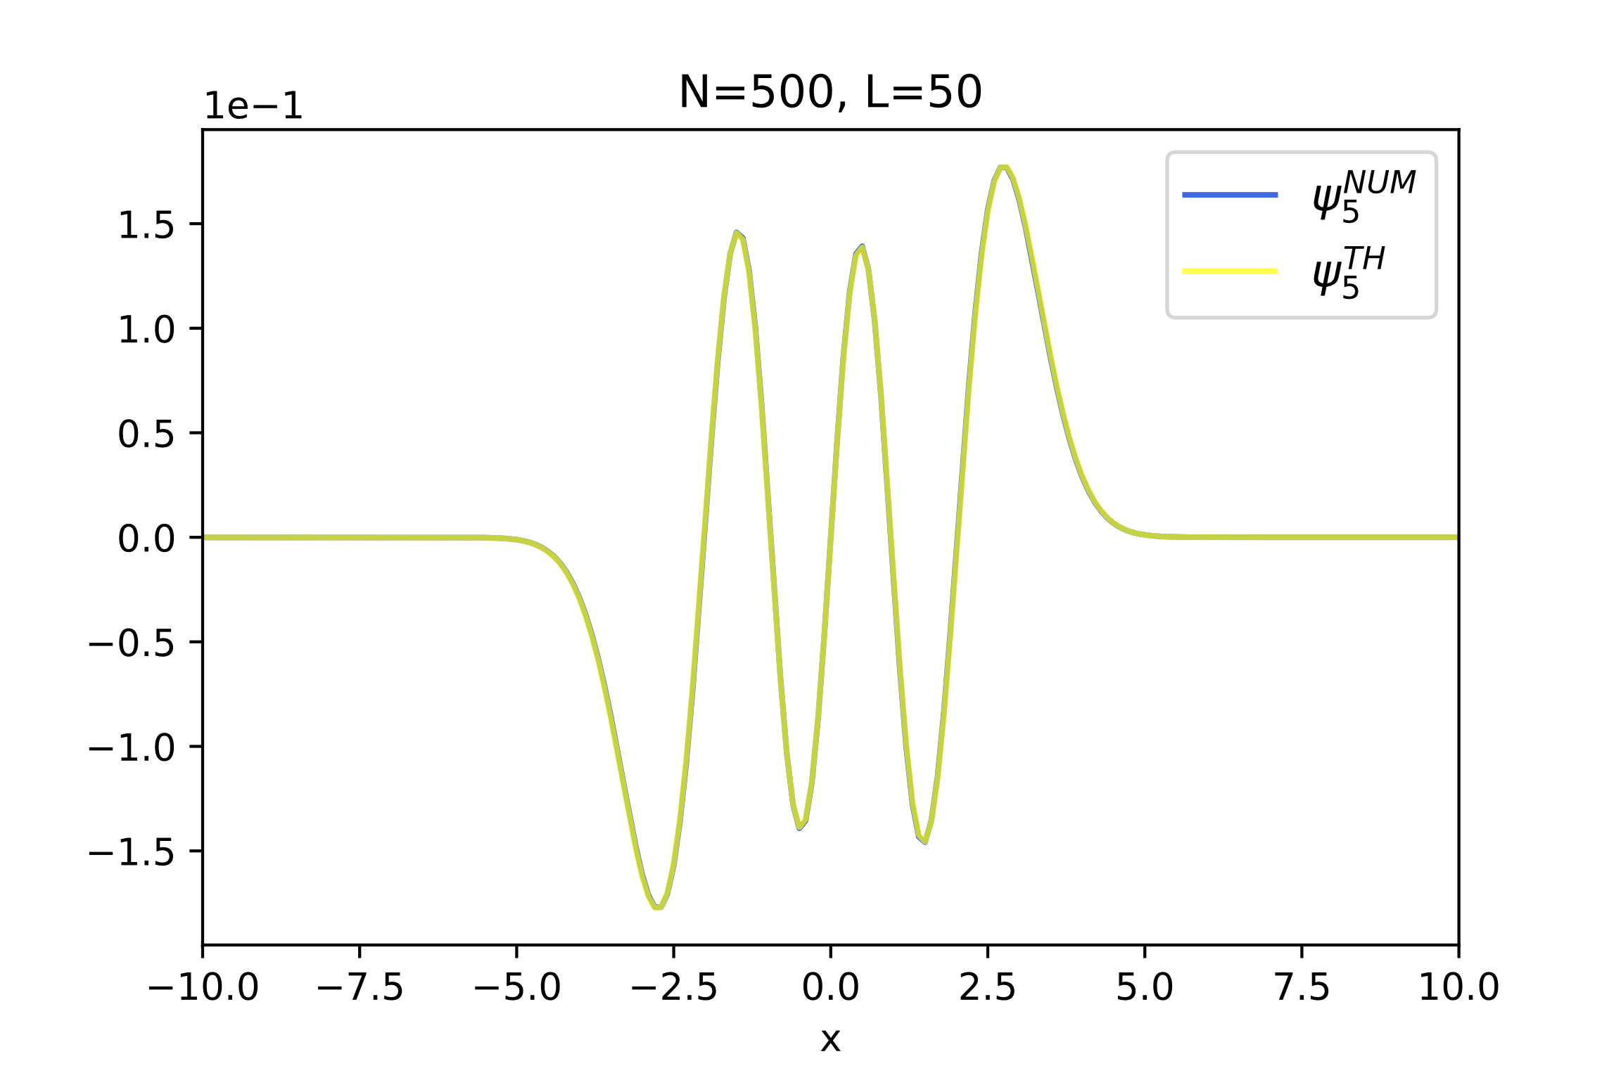
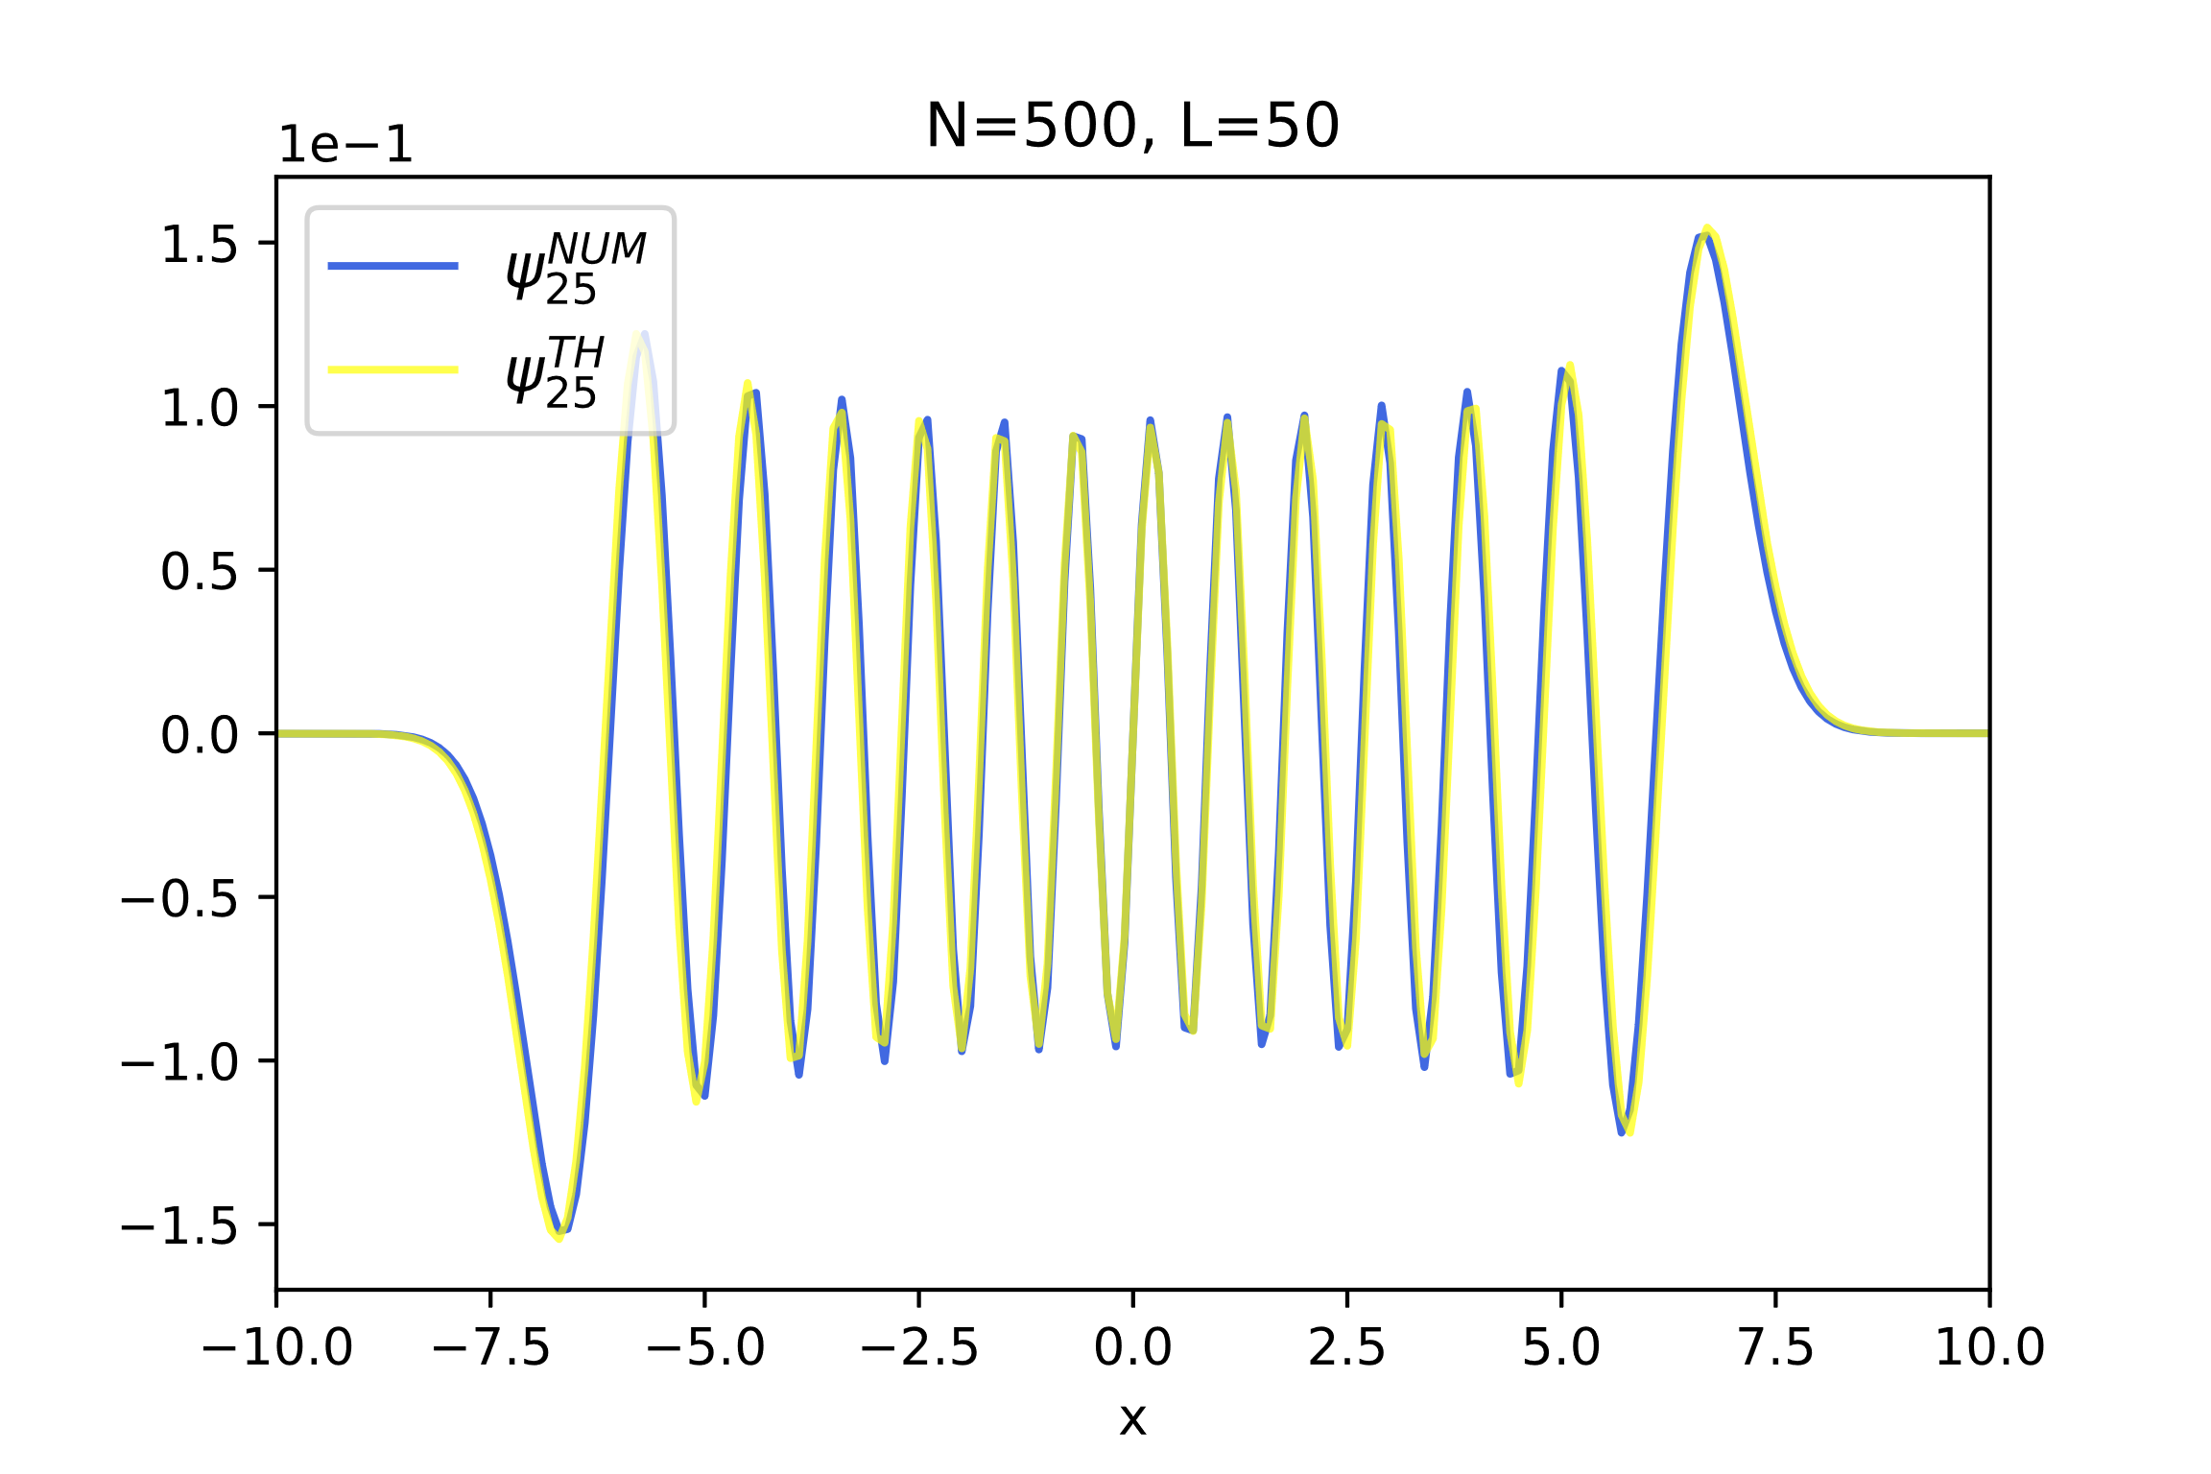
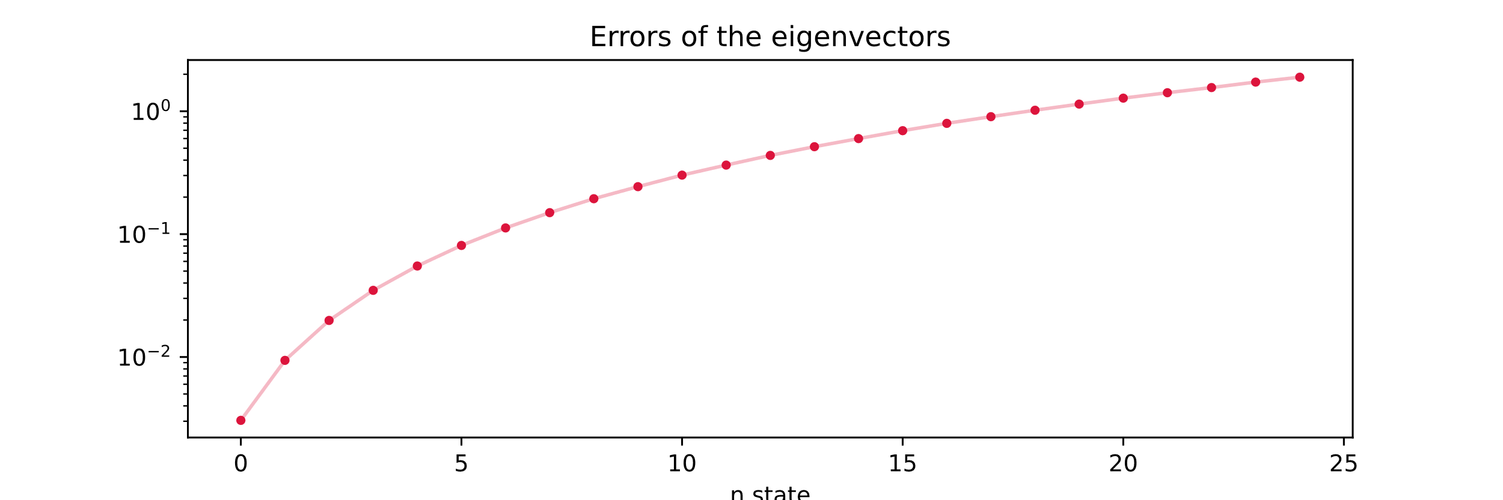


Results
$$ψ_{n}^{TH}\left(x\right)=\frac{1}{\sqrt{2^{n}n!}}{\left(\frac{ω}{π}\right)}^{\frac{1}{4}}e^{−\frac{ωx^{2}}{2}}H_{n}\left(\sqrt{ω} x\right), n=0, 1, 2, …$$
$${err(ψ}_{n})=\sum_{i}^{N}{|ψ_{n}^{TH}\left(x_{i}\right)−ψ_{n}^{NUM}(x_{i})|}$$
Notes:
Present data and explain your results

Slide 6
Self evaluation
Correctness: Hugely depends on the choice of the parameters. It can
be still improved by using a better formula for the derivative
Stability: Various checks have been implemented to make the program
as stable as possible
Accurate discretization: For the right parameters (for example L=50 and
N=1000) the programs gives accurate results
Flexibility: Based on ZHEEV and not DSTEMR for generalizing to other
problems
Efficiency: Can be improved by considering DSTEMR and real-only matrices
Notes:
Present data and explain your results

Slide 7
Thanks for the attention
___________________________

